Slide 1
Introduction to MATLAB
Summer Internship Program Coding Course
2024
Polina Cherepanova
cherepanova@princeton.edu
Polina Iamshchinina
pi7127@princeton.edu

Slide 2
Course overview
Tuesdays and Thursdays, 2-3 pm
PNI A02 (except June 25 & 27 in A30)
Office hours by appointment (email us!)
Weekly assignments assigned each Thursday, due the following Thursday before class
Course github: https://github.com/polcher/pni-summer-intro-matlab-2024

Slide 3
Course overview (subject to change)
June 6: Introduction, variables
June 11 and 13: Arrays and matrices
June 18 and 20: Functions and operators
June 25 and 27: Loops and plotting intro
July 2: Plotting and transition to advanced MATLAB

Slide 4
Course overview
We want to encourage a welcoming and safe space for everyone to ask questions
Practice makes progress!
Group work highly encouraged
If you run into problems, Google and Stack Overflow will likely have solutions

Slide 5
Some other excellent resources to learn MATLAB
Please check these excellent resources:
Github repo by Mai Nguyen
MIT Open courseware

Slide 6
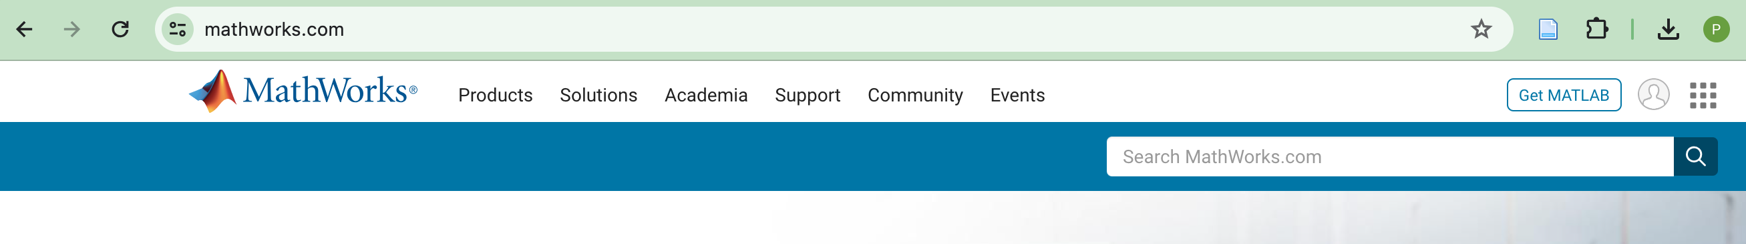
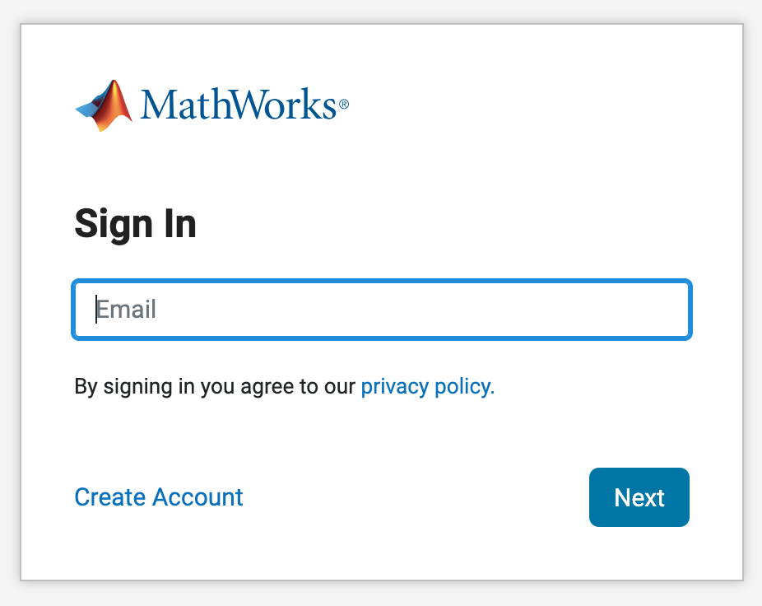
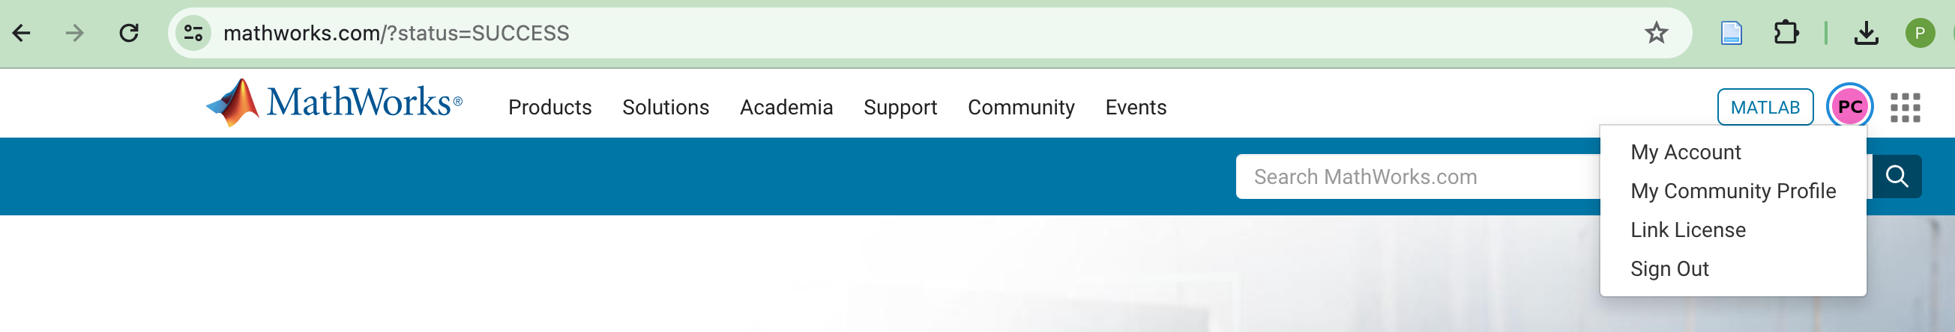
Setting Up MATLAB
1) Go to www.mathworks.com
2) Click account icon
3) Sign in if you have an account, or create new account w/ Princeton credentials
4) Navigate to My Account

Slide 7
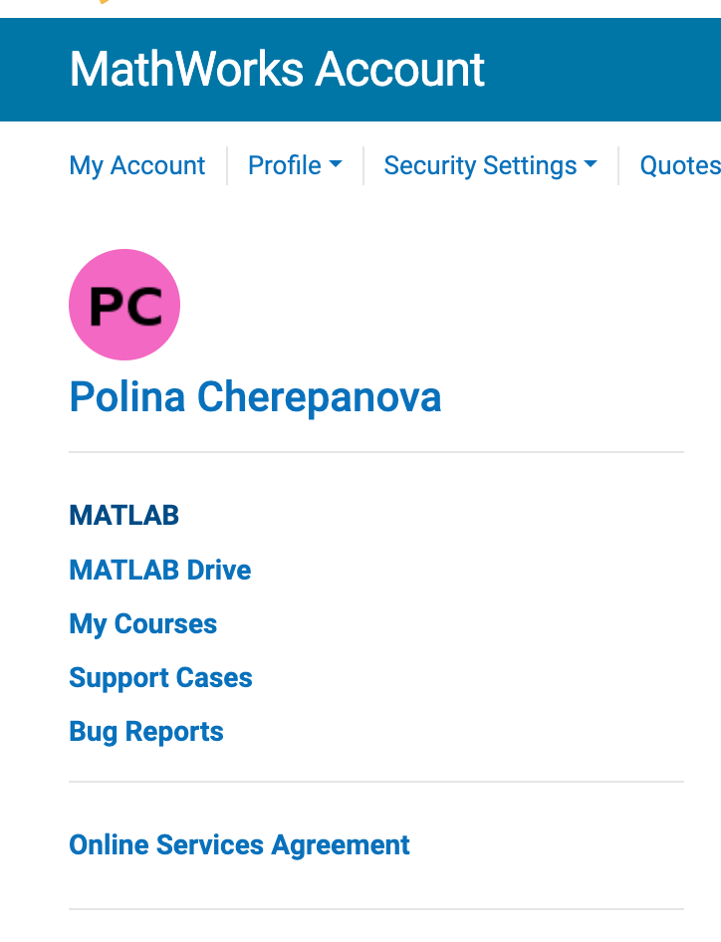
Setting Up MATLAB
Click to access MATLAB Online (bookmark this page!)
Click to access MATLAB Drive and upload files from github repo

Slide 8
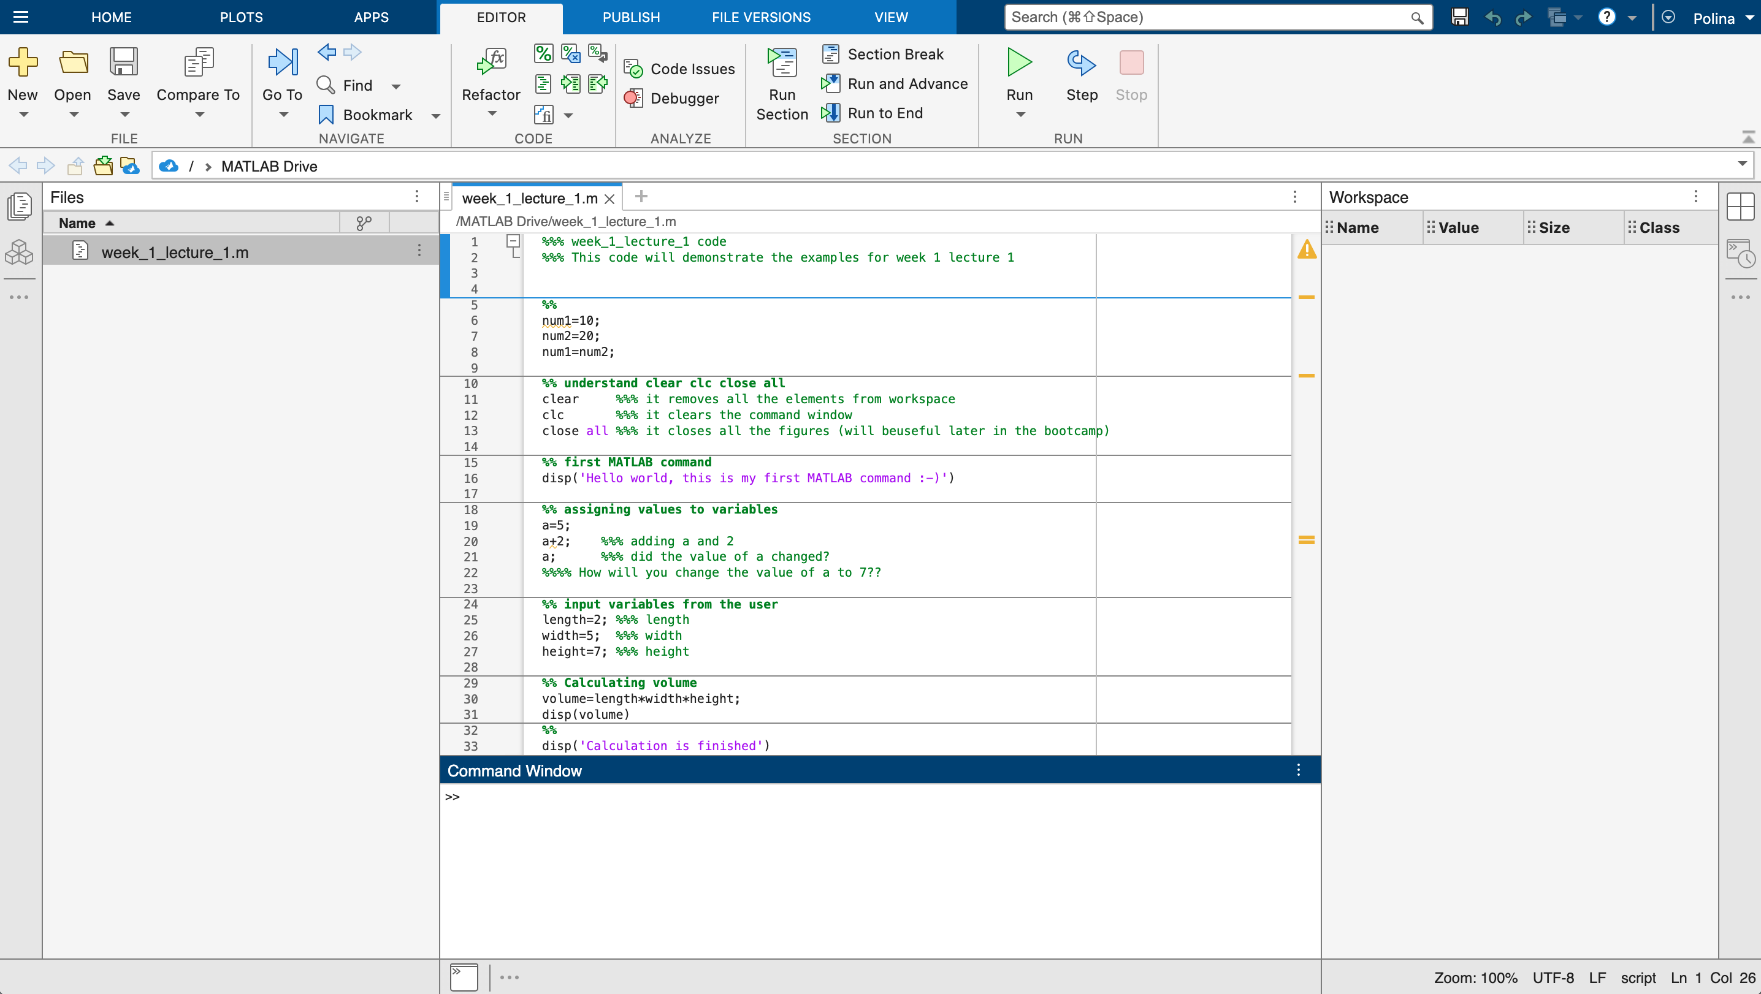
Working directory
Files in the working directory
Workspace variables
script
Command window

Slide 9
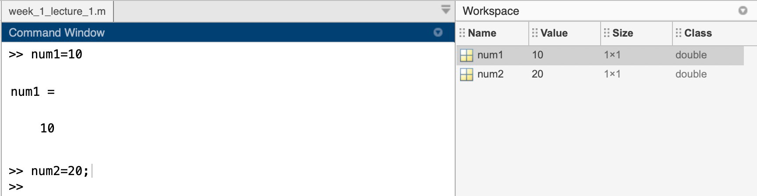
This is how you define a variable:
Here we created a new variable num1 and assigned it a value of 10
Note that the information always transfer from right to left! (try num1=num2; and see what is the new value of num1)
Observe that once you assign values to the variables they appear in the workspace
Can you tell the effect of using semicolon (;) at the end of command line?

Slide 10
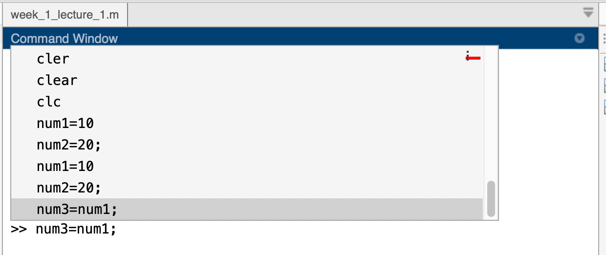
Helpful tips for MATLAB
You can press the up arrow and select any of the previous commands.
You can autocomplete the name of a variable by pressing on tab key

Slide 11
clear, clc, close all
clear
clc
close all
removes all the elements from workspace
clears the text in the command window
closes all the figures (will be useful later)
I usually include all these commands at the beginning of each matlab script

Slide 12

First MATLAB command
MATLAB In-
built function
Input to the function passed inside the brackets
Output of the function

Slide 13
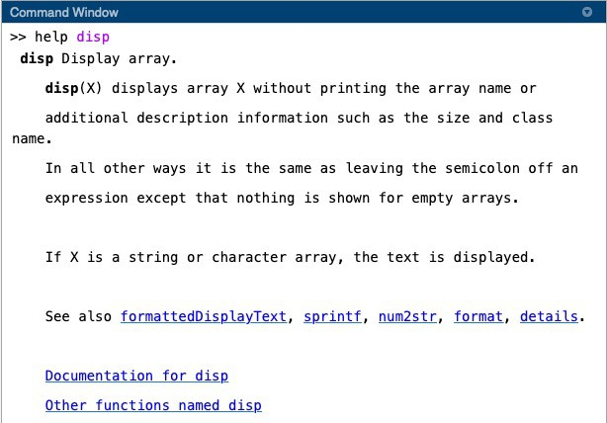
Help function in MATLAB

Slide 14
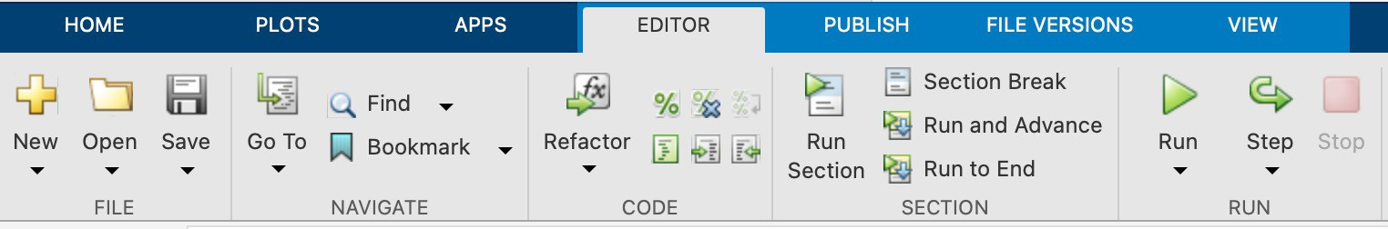
Options for Running your MATLAB script
Running from command window
Run section
Run and advance
Run to end
Run

Slide 15
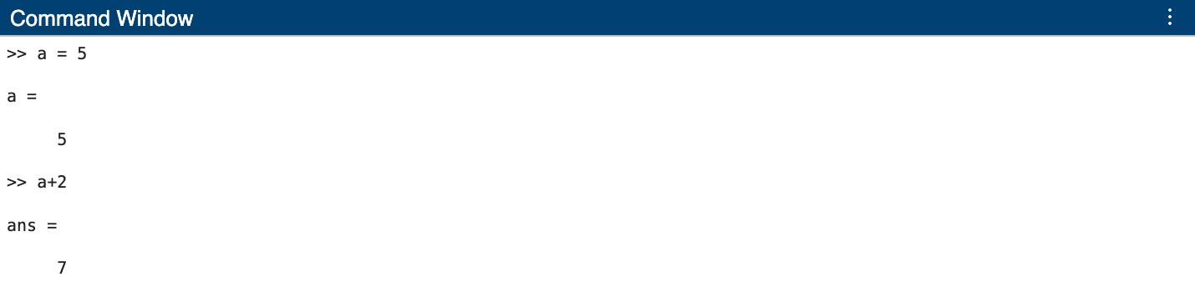
Assigning values to variables
a=5;
a+2
What is the new value of a?
How can you increase the value of variable ‘a’ by 2?

Slide 16
Calculation using variables
volume= length x width x height
length=2;
width=5;
height=7;
volume=length*width*height;
How will you print the value of the variable `volume`?
How will you print the values of `volume` and `width` together?

Slide 17
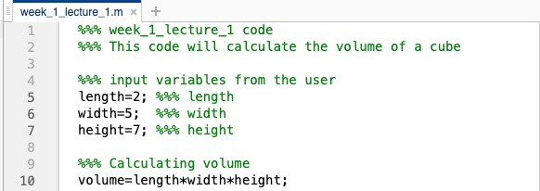
Using MATLAB editor
Any line of code which begins with % is considered as comment and is not executed by MATLAB.
Using %% will divide the code into sections (very helpful)
Adding comments at the very top of the code will be displayed when you use help filename.m

Slide 18
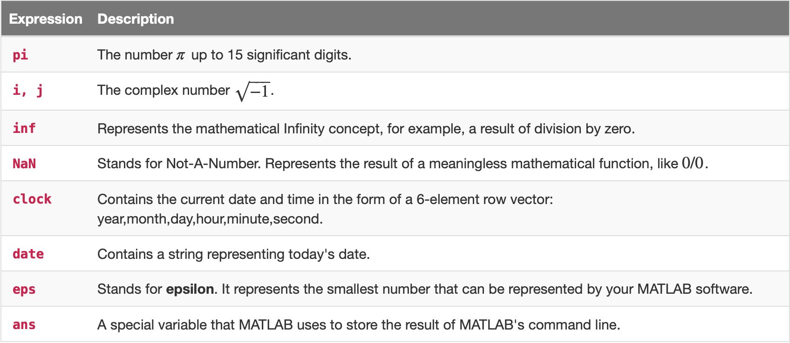
Predefined values and variables in MATLAB
https://www.cdslab.org/matlab/notes/values-variables-types/variables/index.html

Slide 19
Keywords in MATLAB
MATLAB has pre-defined keywords such as while, for, if, parfor, global etc.
You cannot use these keywords as a variable e.g. you cannot use while=1;
To see the complete list of keywords, enter iskeyword in the command window.
Also, try not to use MATLAB functions as variable names. For e.g. avoid using mean=4, sin=20, etc.

Slide 20
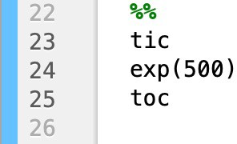
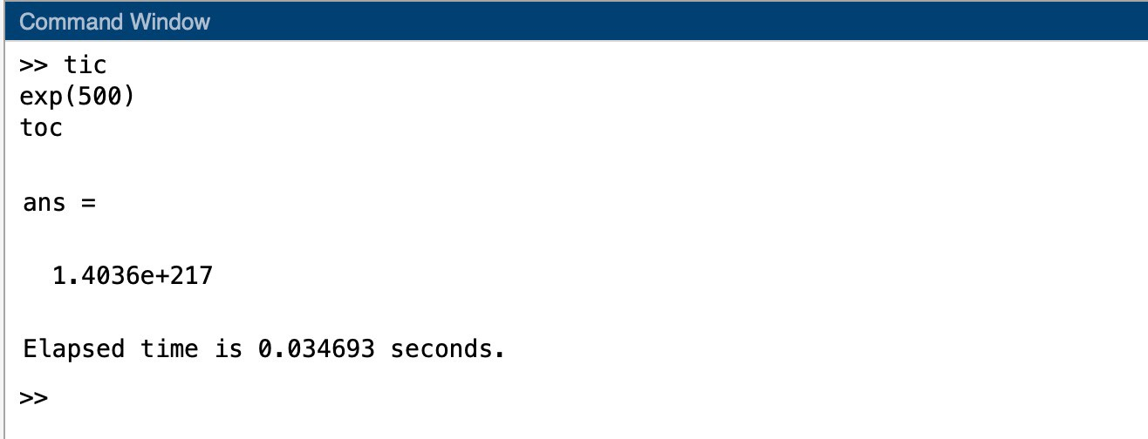
Time taken by MATLAB to execute a code
MATLAB tells the time to execute a command between tic and toc

Slide 21
Infinity and NaN (Not a number)
Inf: Inf is the outcome of division by 0 (e.g. 1/0) or overflow when the result is too large (e.g. exp(1000))
NaN: MATLAB uses NaN to represent the numbers which are not real or complex. e.g. 0/0, Inf/Inf
Usually in experiments/data analysis, the missing data points are represented by NaN.
https://www.mathworks.com/help/matlab/matlab_prog/infinity-and-nan.html

